Slide 1

K.S. INSTITUTE OF TECHNOLOGY
(Affiliated to VTU, Belagavi & Approved by AICTE, New Delhi, Accredited by NAAC & IEI)
Department of Computer Science and Engineering
Project Work Phase-I (18CSP77)
Project on
A NEW IoT GATEWAY FOR SMART AGRICULTURE
Batch no:2021_22_CSE_10
Team members:
Poojashree K 1KS18CS067
Rekha N.C 1KS18CS082
Shalini S 1KS18CS090
Preethi K 1KS18CS072
Under the guidance of : Dr. K. Venkata Rao Professor
Dept. of CSE,KSIT

Slide 2
CONTENTS
Introduction
Literature Survey
Problem Identification, Statement and Scope
Goals and Objectives
Methodology
Contribution to Society
References

Slide 3
INTRODUCTION
In general, agriculture is the backbone of India and also plays an important role in Indian economy by providing a certain percentage of domestic product to ensure the food security.
Farming holds an important place in the growth of the nation as It holds a great share in our Indian economy.
But if we compare our level of irrigation from other countries we are far away from them till today our agriculture system still relies on the traditional approach as others are using new approach day by day.
Hence this project aims to convert the irrigation to smart irrigation by using high technology and the Internet of things.

Slide 4
LITERATURE SURVEY
SI No. | Author and Publication details | Problem focused | Technology | Performance | Outcome
1. | “Internet of Things (IoT) : A vision, architectural elements, and security Issues” Author: Shivangi Vashi, Saurav Verma Published in: I-SMAC 2017 | This paper provide the basic understanding of IoT, its Architecture, Security issues and Measures. | IoT Architecture have 5 layers: 1.Perception layer 2.Network layer 3.Middle ware layer 4.Application layer 5.Business layer | To Understand the performance of IoT and its architecture they have taken one example of “A SMART WORLD”. | IoT is the future of the coming decades which helps to develop smart world without any security issues.
2. | “IoT solutions for crop protection against wild animal attacks” Authors: Stefano Giordano, Ilias Seitanides, Mike Ojo, Davide Adami. Published in: IEEE 2018 | This study aimed to protect the crop against animals and birds that enter into the field. | It is using the repeller system which makes use of PIR sensor to detect motion and it also has weather monitoring system which contains temperature and humidity sensor. | PIR sensor activates the driver responsible for the ultrasound generation and as well as the networking communication only when an animal is detected.Weather monitoring system can able to estimate the probability of pest attack. | This work provides a repelling and monitoring system for crop protection against animal attacks and weather conditions.

Slide 5
SI No. | Author and Publication details | Problem focused | Technology | Performance | Output
3. | “Implement Smart Farming with IoT Technology” Authors: Chiyurl Yoon, Miyoung Huh, Shin-Gak Kang, Juyoung Park, Changkyu Lee Published in: ICACT 2018 | Implementation of wireless communication for communicating between the nodes which are having sensors and the control device like mobile phone. | It is using LPWAN (low power wide area network)for wireless communication. | The nodes collects the environmental and growth data from greenhouse and send it to user control device through LPWAN which enables MQTT communication based on IP from gateway to server. Then the user can take further action. | All the information regarding environment should be provided to user using the control device without any data loss.
4. | “Precision agriculture using remote monitoring systems in Brazil” Authors: Rodrigo Filev Maia, Ibrahim Netto, Anh Lan Ho Tran Published in: IEEE 2017 | This paper describes a real-time agricultural internet of things device designed to monitor the state of soil and environment. | Raspberry Pi controls the data acquisition. ZigBee for communication between nodes. Cloud is used to organize all information from several nodes | The monitoring nodes are installed in the several places in the field with sensors to monitor both soil and the environment. These nodes connect and send data to the central node using ZigBee network. The central node store data from all monitoring node and send them to the cloud through the internet. | The local climatic condition is sent to the user using internet to support decisions on irrigation and other activities related to crop health.

Slide 6
SI No | Author and Publication details | Problem focused | Technology | Performance | Output
5. | “IoT Based Precision Agriculture using Agribot” Authors: Mr. V. Gowrishankar ,Dr. K. Venkatachalam Published in: GRD Journal for Engineering 2018 | This project has developed a robot called Agribot which is used for performing basic agriculture operations like spraying water and pesticide, sowing of seeds, ploughing and so on. | Arduino is used to control various operations. L293D driver for proper movement of wheels. | Ploughing ,seed sowing is done simultaneously as the robot moves forward. spraying of pesticides can be done with the help of solenoid valve and is periodically sprayed whenever the relay switch is closed. | This project helps to perform basic agriculture operations automatically without any manual work in the field.
6. | “Animal Identification Using Deep Learning on Raspberry Pi” Authors: Utsav Dihingia, P. Amar, M. Megha Shyam, Vaibhav Thomas Published in: IJRESM 2020 | The purpose of this project is to build a system that detects animals which enter into form or any household. | This system detects and classifies animals in real-time by implementing a convolution neural network(CNN). | A video is fed into the raspberry pi, wherein we run a Python based program with some dependencies to identify the animal and classify it into categories. | The output can predict and identify the object efficiently at any time.

Slide 7
PROBLEM IDENTIFICATION, STATEMENT AND SCOPE
PROBLEM IDENTIFICATION:-
Major problem in using IoT is security issue.[1]
Using PIR sensor without using pi camera will simply ON the buzzer who ever enters into the field.[2]
Using wireless communication without any data loss.[3]
Collecting only data from the sensor without any automatic activity.[4]
Using big and separate robot for all agriculture activity[5].
Without using pi camera manually inserting video into the raspberry pi for animal detection[6].
To eliminate all these flaws, A New IoT gateway for Smart Agriculture will be of great help.

Slide 8
PROBLEM STATEMENT :-
The problem statement defined is , “Designing an automated robot for performing all the agriculture related operations , to scare the animals that enter into the field, providing irrigation facility by knowing the soil condition and to develop a warehouse management system using different sensors”.
SCOPE:-
All the operations are controlled using mobile phone.
Should have internet connection.
Range between mobile phone and field is limited.

Slide 9
GOALS AND OBJECTIVES
GOAL:-
Goal of the project is to design an integrated automated system that gives an advance method to perform all agricultural activities with minimum man power and to improve the productivity.
OBJECTIVES:-
To build a robot that can do all basic agricultural activities including scaring of animals that enter into the field.
Warehouse management system to provide suitable environment for storing crop.
To build communication network between the nodes and user using blynk application

Slide 10
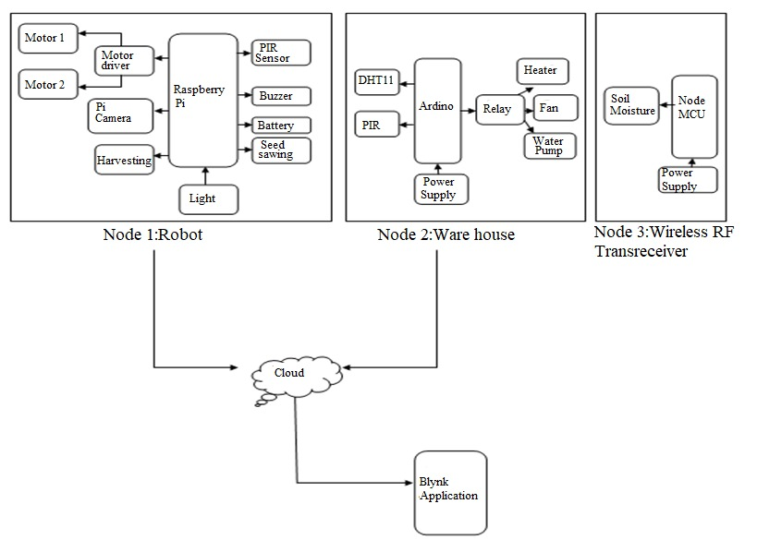
METHODOLOGY

Slide 11
In this project we will be fabricating a multipurpose irrigation vehicle that will be able to DIG the Earth, Sow the seeds and Cultivate the crop after the harvest is ready.
We will be using an android smart phone application to control the vehicle to respond to the control signal .
This type of vehicle should be useful for the farmers as a low investment option instead of buying 2 or more machines to do this work done by a single machine of ours that is the Robotic node.
The next is warehouse node in which it will measure the temperature and humidity and also if any rats and rodents present in the warehouse we will get the information to mobile phone .
Next node is Wireless RF Transreceiver it will measure the moisture content in the soil from the crop field all this information send to the cloud through IoT and from the cloud we can access the information from the mobile application so that the necessary actions will be taken.

Slide 12
CONTRIBUTION TO SOCIETY
This Project will be having major contribution to the society, specially in the development of agriculture field.
It is focused on helping farmers close the supply demand gap, by ensuring high yields, profitability and protection of the environment.
It enables growers and farmers to reduce manpower and to enhance the productivity using limited availability of resources.
Human-wildlife conflict such as crop destruction, competition for grazing lands and injury and death to human, damage to infrastructure can be controlled using robot.
Water overflow issue, volume problem is solved by the robot which is remote controlled, the soil distribution centre and the water structure are different from others.
Warehouse management helps in terms of quality maintenance and theft detection can prevent loss.

Slide 13
REFERENCES
[1] Shivangi Vashi, Jyotsnamayee Ram, Janit Modi, Saurav Verma and Dr. Chetana Prakash, "Internet of Things (IoT): A vision, architectural elements, and security issues," 2017 International Conference on I-SMAC (IoT in Social, Mobile, Analytics and Cloud) (I-SMAC), Palladam, 2017, pp. 492-496.
[2]Stefano Giordano, Ilias Seitanidis , Mike Ojo, Davide Adami and Fabio Vignoli, "IoT solutions for crop protection against wild animal attacks," 2018 IEEE International Conference on Environmental Engineering.
[3] Chiyurl Yoon, Miyoung Huh, Shin-Gak Kang, Juyoung Park and Changkyu Lee, "Implement smart farm with IoT technology," 2018 20th International Conference on Advanced Communication Technology (ICACT), Chuncheon-siGangwon-do, Korea (South), 2018, pp. 1-2.
[4] Rodrigo Filev Maia, Ibrahim Netto and Anh Lan Ho Tran, "Precision agriculture using remote monitoring systems in Brazil," 2017 IEEE Global Humanitarian Technology Conference (GHTC), San Jose, CA, 2017, pp. 1-6.
[5] Mr. V. Gowrishankar and Dr. K.Venkatachalam ,”IoT Based Precision Agriculture using Agribot”,2018 GRD Journal for Engineering ISSN:2455-5703
[6] Utsav Dihingia, P. Amar, M. Megha Shyam, Vaibhav Thomas, S. Chidambaram, “Animal Identification Using Deep Learning on Raspberry Pi”,2020 International Journal of Research in Engineering, Science and Management(IJRSESM).

Slide 14
THANK YOU

